Slide 1
Module 3
Asymmetric Encryption Algorithm and Key Exchange
Topic:
ElGamal Cryptography

Slide 2
ElGamal Cryptography
Public-key scheme based on discrete logarithms, closely related to the D-H
Used in DSS and S/MIME email standard
The global elements of Elgamal are a prime number q and α, which is a primitive root of q
User A generates a private/public key pair as follows:
  Chooses a Random integer (PK): 1 < X_{A} < q – 1
  Computes their public key: Y_{A} = α^{XA} mod q
  A’s Private key is X_{A,} A’s Public key pairs {q, α, Y_{A)}
  A’s private key is XA and A’s public key A’s
Notes:
In 1984, T. Elgamal announced a public-key scheme based on discrete logarithms, closely related to the Diffie-Hellman technique [ELGA84, ELGA85]. The ElGamal cryptosystem is used in some form in a number of standards including the digital signature standard (DSS) and the S/MIME email standard. As with Diffie-Hellman, the global elements of ElGamal are a prime number q and a, which is a primitive root of q. User A generates a private/public key pair as shown. The security of ElGamal is based on the difficulty of computing discrete logarithms, to recover either x given y, or k given K (next slide).

Slide 3
ElGamal Message Exchange
Any user B that has access to A’s public key can encrypt a message as follows: (User B to User A)
Represent the message as an integer M in the range 0 ≤ M ≤ q - 1. Longer messages are sent as a sequence of blocks, with each block being an integer less than q. (M < q)
Choose a random integer, k such that 1 ≤ k ≤ q - 1. (So, k < q)
Compute a one-time key, K = (Y_{A})^{k} mod q.
Encrypt M as the pair of integers (C₁, C₂) where,
C₁ = α^{k} mod q; C₂ = K.M mod q
Notes:
Any user B that has access to A's public key can encrypt a message as shown. These steps correspond to Figure 9.1a in that Alice generates a public/private key pair; Bob encrypts using Alice's public key; and Alice decrypts using her private key. See text for details of why these steps result in M being recovered. Note that K functions as a one-time key, used to encrypt and decrypt the message. If a message must be broken up into blocks and sent as a sequence of encrypted blocks, a unique value of k should be used for each block. If k is used for more than one block, knowledge of one block m of the message enables the user to compute other blocks as shown in the text.
The basic idea with El Gamal encryption is to choose a random key, protect it, then use it to scramble the message by multiplying the message with it. Two bits of info have to be sent: the first to recover this temporary key, the second the actual scrambled message. See that El Gamal encryption involves 1 modulo exponentiation and a multiplication (vs 1 exponentiation for RSA).

Slide 4
ElGamal Message Exchange
User A recovers the plaintext as follows:
  Recover the key by computing K = C₁ ^{XA} mod q
  Compute M = C₂ K⁻¹ mod q
A unique K must be used each time
  Otherwise result is insecure
Notes:
Any user B that has access to A's public key can encrypt a message as shown. These steps correspond to Figure 9.1a in that Alice generates a public/private key pair; Bob encrypts using Alice's public key; and Alice decrypts using her private key. See text for details of why these steps result in M being recovered. Note that K functions as a one-time key, used to encrypt and decrypt the message. If a message must be broken up into blocks and sent as a sequence of encrypted blocks, a unique value of k should be used for each block. If k is used for more than one block, knowledge of one block m of the message enables the user to compute other blocks as shown in the text.
The basic idea with El Gamal encryption is to choose a random key, protect it, then use it to scramble the message by multiplying the message with it. Two bits of info have to be sent: the first to recover this temporary key, the second the actual scrambled message. See that El Gamal encryption involves 1 modulo exponentiation and a multiplication (vs 1 exponentiation for RSA).

Slide 5
Working of Elgamal scheme
First, we show how K is recovered by the decryption process:
  K = (Y_{A})^{k} mod q K is defined during the encryption process
  K = (α^{XA} mod q)^{k} mod q Substitute using Y_{A} = α^{XA} mod q
  K = α^{k.XA} mod q by the rules of modular arithmetic
  K = (α^{k} mod q) ^{XA} mod q
  K = (C₁)^{XA} mod q Substitute using C₁ = a^{k} mod q

Slide 6
Working of Elgamal scheme
Next, using K, we recover the plaintext as:
  C₂ = KM mod q
  M =C₂K⁻¹mod q

Slide 7
Elgamal process
Bob generates a random integer, k.
Bob generates a one-time key, K using Alice’s public-key components Y_{A}, q, and k.
Bob encrypts k using the public-key component α, yielding C₁. C₁ provides sufficient information for Alice to recover K.
Bob encrypts the plaintext message M using K.
Alice recovers K from C₁ using his private key.
Alice uses K⁻¹ to recover the plaintext message from C₂.

Slide 8
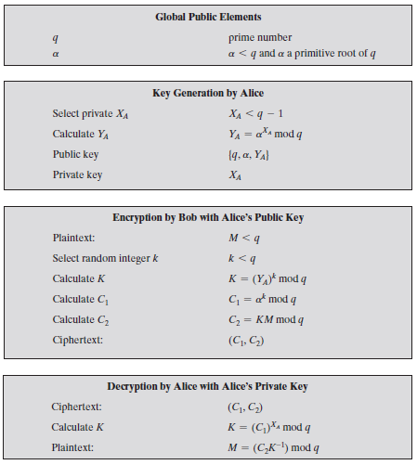
The Elgamal Cryptosystem - Process

Slide 9
ElGamal Example
Use field GF(19) q = 19 and α =10
Alice computes her key:
  A chooses X_{A} = 5 & computes Y_{A}=10⁵ mod 19 = 3
Bob send message M =17 by
  Choosing random k = 6
  Computing K = Y_{A}^{k} mod q = 3⁶ mod 19 = 7
  Computing C₁ = α^{k} mod q = 10⁶ mod 19 = 11;
  C₂ = KM mod q = 7.17 mod 19 = 5
Alice recovers original message by computing:
  Recover K = C₁^{XA} mod q = 11⁵ mod 19 = 7
  Compute inverse K⁻¹ = 7⁻¹ mod 19 = 11
  Recover M = C₂ K⁻¹ mod q = 5 x 11 mod 19 = 17
Notes:
Here is an example of ElGamal from the text using the prime field GF(19); that is, q = 19. It has primitive roots {2, 3, 10, 13, 14, 15}, as shown in Table 8.3. We choose a = 10. Alice generates a key pair as shown. Suppose Bob wants to send the message with the value M = 17. Then he computes the ciphertext pair (11, 5) and sends this to Alice. Alice recovers the message by first recovering K, then computing its inverse (using the Extended Euclids Algorithm – see Ch 4), and finally recovering M.

